Slide 1
Programming JAVA {
Hiveed.java
String;
/* Here is where your journey for your dream begins */
}
JAVA Programming

Slide 2
STRING :
Hiveed.java
Sequence of Charater used to represent the text data.
Fumdamental building block for many applications.
String is non-primitive type datatype.
Built-in class in java present in the ( java.lang.String ) .This represent the string Class
JAVA Programming

Slide 3
ways to ctreate the String :
Hiveed.java
1.Using String Literals :
Enclosed in Double quotes “
Example String name=”HIVEED”;
2.Using the new Keyword :
More explicit way to Create a String Object.
Example : String name=new String (“HIVEED”);
JAVA Programming

Slide 4
Properties of the String :
Hiveed.java
String is immutable.
Any modification result in a new String Object.
Why String is immutable and How ?
Immutable objects are objects Which once declared elements can’t be modified after it.
Because in java String Content is stored in single pool to minimize creating a copy of the same value. And it is Same for all Wrapper Class.
JAVA Programming

Slide 5
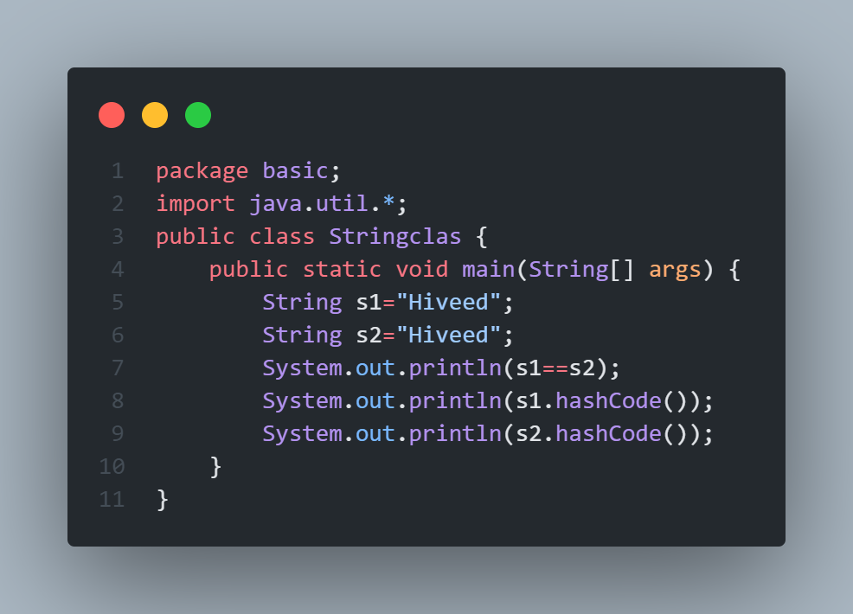
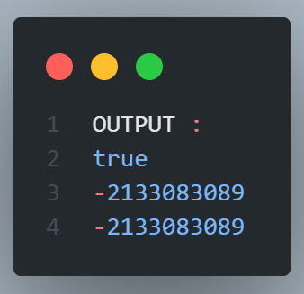
Guess The Output:
Hiveed.java
JAVA Programming

Slide 6
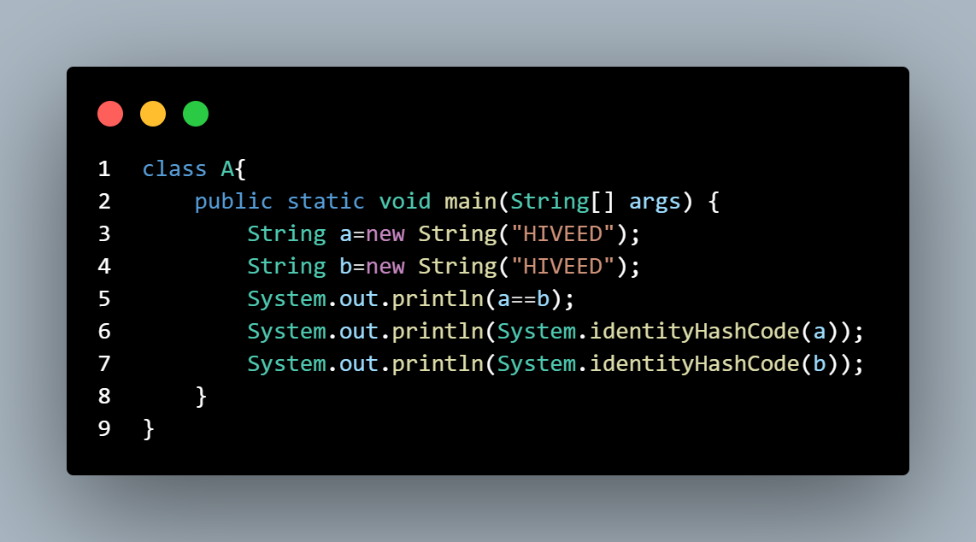
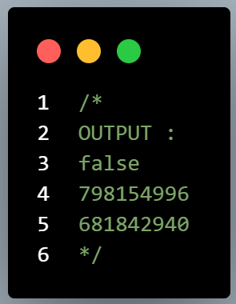
Guess The Output:
Hiveed.java
JAVA Programming

Slide 7
Result discussion :
Hiveed.java
Whenever the programmer create the string using new keyword it generates the new address.
Which means it String stores in new address.
JAVA Programming

Slide 8
String inbuilt methods :
Hiveed.java
Methods | Description | Return Type
charAt() | Returns the character at the specific index | char
compareTo() | Compare two String lexicographically | int
compareToIgnoreCase() | Compare string lexicographic and ignore case | int
concat() | Append the String | String
contains() | Check the particular sequence is present in the string or not. | boolean
equals() | Compare two string | boolean
JAVA Programming

Slide 9
String inbuilt methods :
Hiveed.java
indexOf() | Return position of the first occurrence in string | int
length() | length of the string | int
trim() | remove extra space | String
toString() | Return the vlaue of the String | String
toUpperCase() | Convert string to Uppercae | String
toLowerCase() | Convert string toLowercase | String
Character.isDigit(charAt(0)) | Check the character is Digit or Not | boolean
JAVA Programming

Slide 10
Solve the String problem :
Hiveed.java
1.Reverse the String.
2.Check the String is Palindrome or Not.
3.Count and print number Uppercase present in the string
4.count and print number of Uppercase , Lowercase , Digit present in the String.
5.print sum of digit present in the string.
6.Reverse the number present in string ip:3hi6jF9 op:9hi6F3
JAVA Programming

Slide 11
StringBuilder & StringBuffer :
Hiveed.java
String is immutable in java to Overcome the problem.
programmer use StringBuffer and StringBuilder These class are mutable.
It is a one of feature of JAVA-8
Performance wise StringBuilder is best.
JAVA Programming

Slide 12
inbuilt-methods :
Hiveed.java
1.append(String s) :
Updates the value of the object that invoked the method. The method takes boolean, char, int, long, Strings, etc.
2.reverse() :
The method reverses the value of the StringBuffer object that invoked the method.
3.delete(int start, int end) :
Deletes the string starting from the start index until the end index.
JAVA Programming

Slide 13
inbuilt-methods :
Hiveed.java
4.public insert(int offset, int i)
This method inserts a string s at the position mentioned by the offset.
5.replace(int start, int end, String str)
This method replaces the characters in a substring of this StringBuffer with characters in the specified String.
JAVA Programming

Slide 14
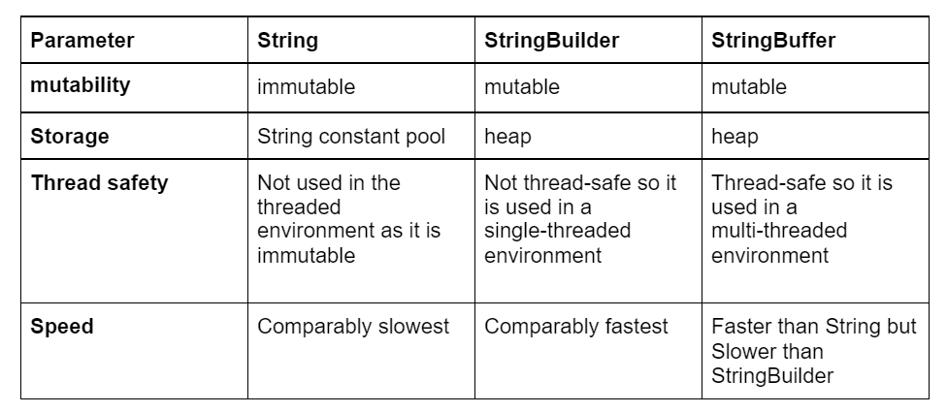
Difference between String StringBuilder && StringBuffer
Hiveed.java
JAVA Programming

Slide 15
Solve the String problem :
Hiveed.java
1.Check the String is anagram or not.
2.Convert the All upperCase to lowercase and all lowerCase to Uppercase in the String.
3.Convert number into integer whithout using inbuilt function.
ip:”123” op:123
4.Remove all special Character present in the String
ip:”^&%jshdhds*(6565)jll” op:jshdhds6565jll
5.Replace the specific Character in the String.
ip : “Elephant” op:”alaphant”
JAVA Programming

